Slide 1
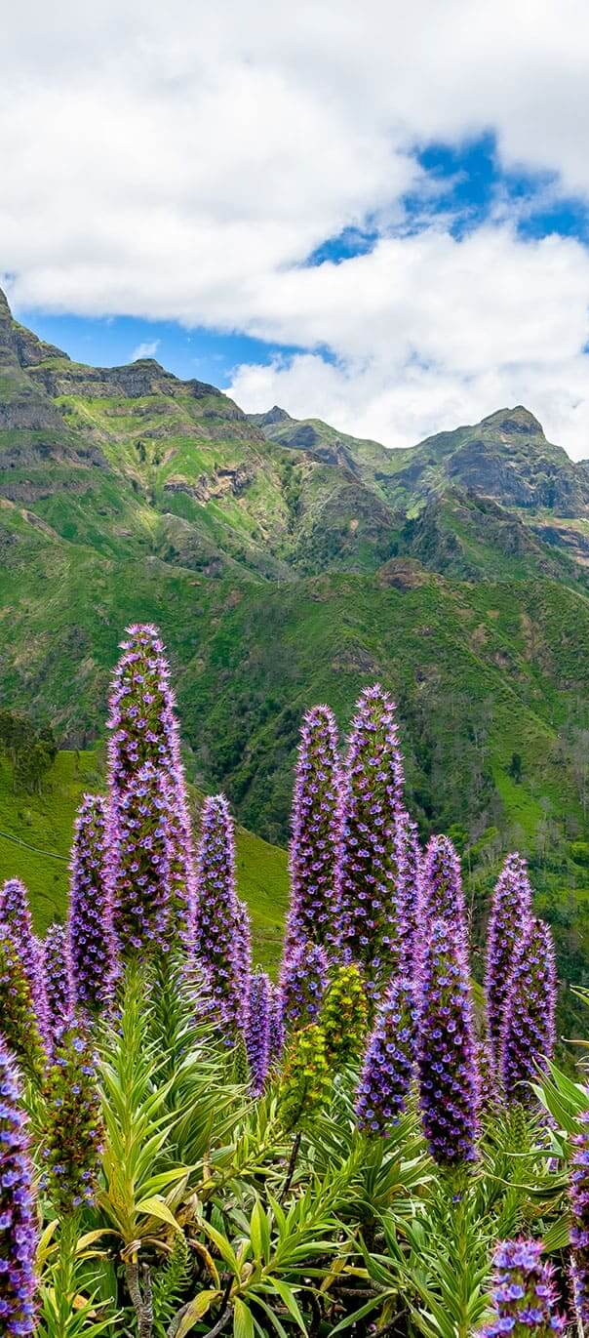
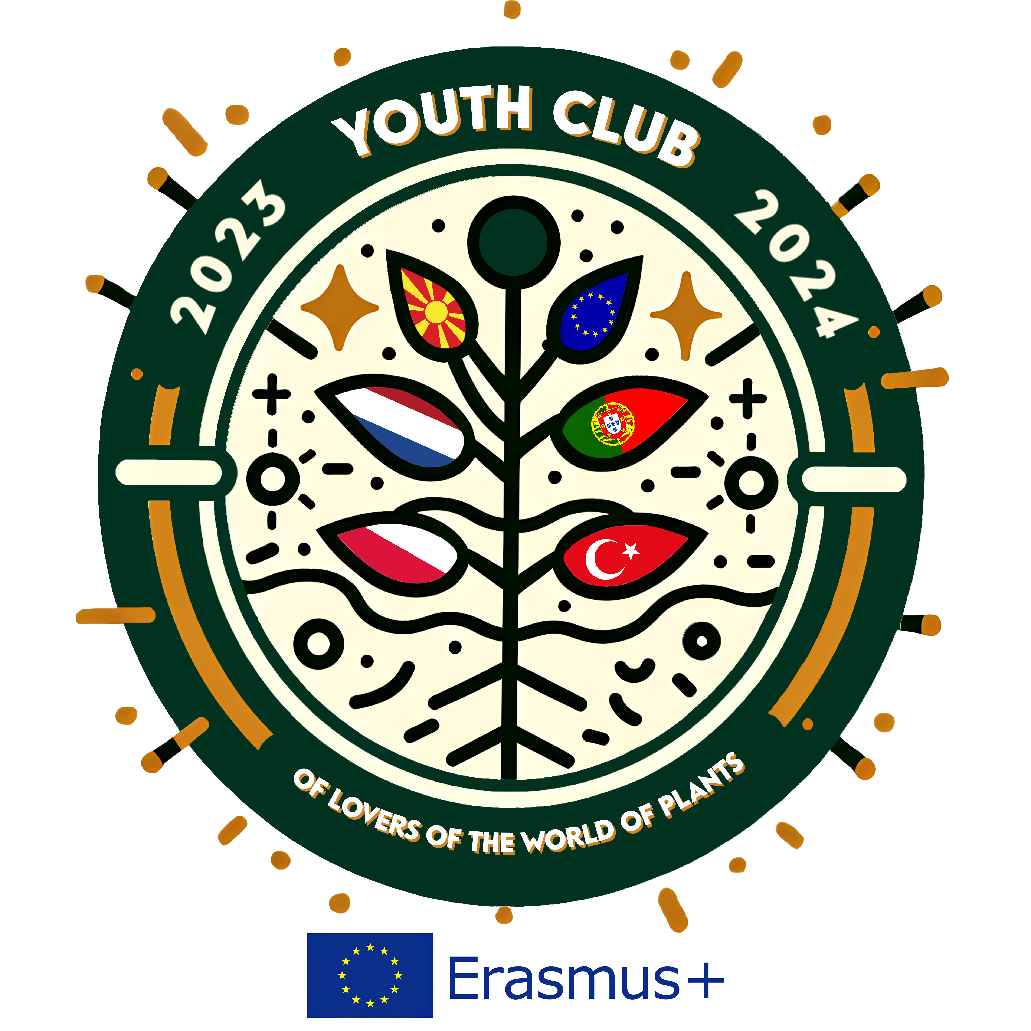
Madeira Island Archipelago and Its Flora
Action under the Project: Youth Club of Lovers of the World of Plants
Erasmus Program + KA210-YOU - Small-scale partnerships in youth;
Project number: 2023-1-PL01-KA210-YOU-000167145.
A Natural Treasure in the Atlantic Ocean

Slide 2
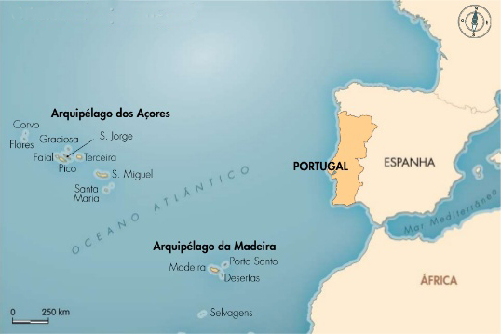
Location and General Information
- Portuguese archipelago in the North Atlantic Ocean
- About 1000 km from Lisbon, 700 km from Africa
- Two inhabited islands: Madeira and Porto Santo
- Volcanic origin with dramatic landscapes

Slide 3
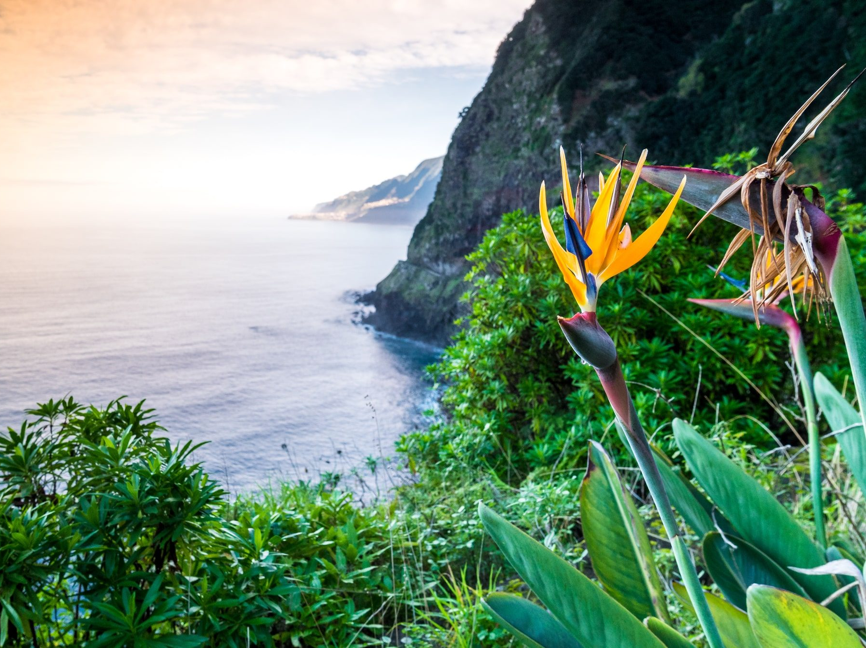
Climate
- Subtropical climate with mild temperatures year-round
- High humidity due to trade winds and ocean currents
- Ideal for lush, diverse vegetation

Slide 4
Flora of Madeira
- Famous for the Laurissilva Forest (UNESCO World Heritage)
- One of the best-preserved subtropical rainforests
- Key species: Til tree, Madeiran laurel, Vinhático
- Many endemic plant species

Slide 5
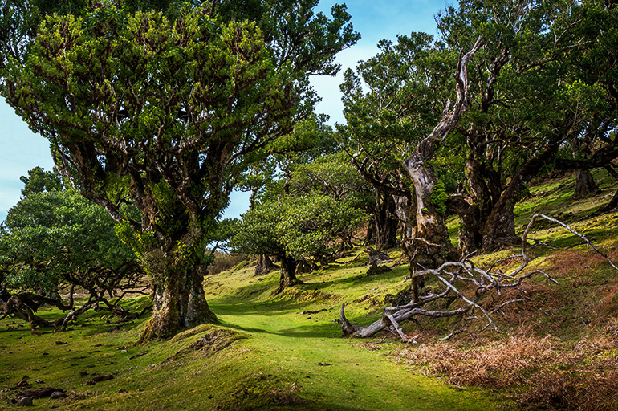
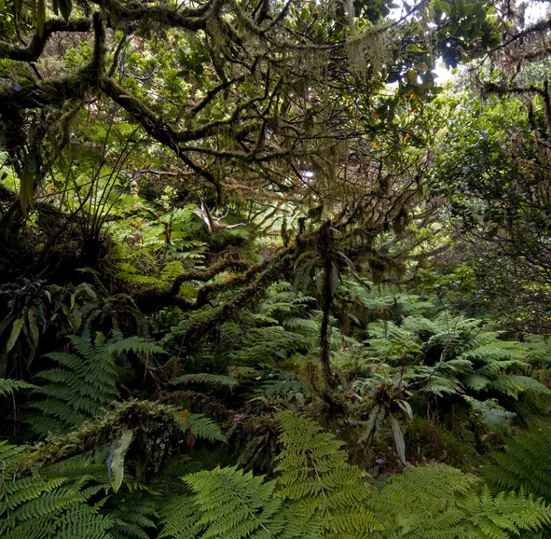
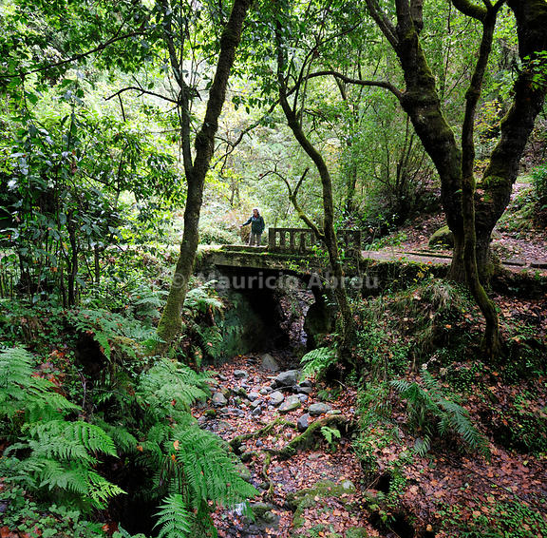
Flora of Madeira

Slide 6
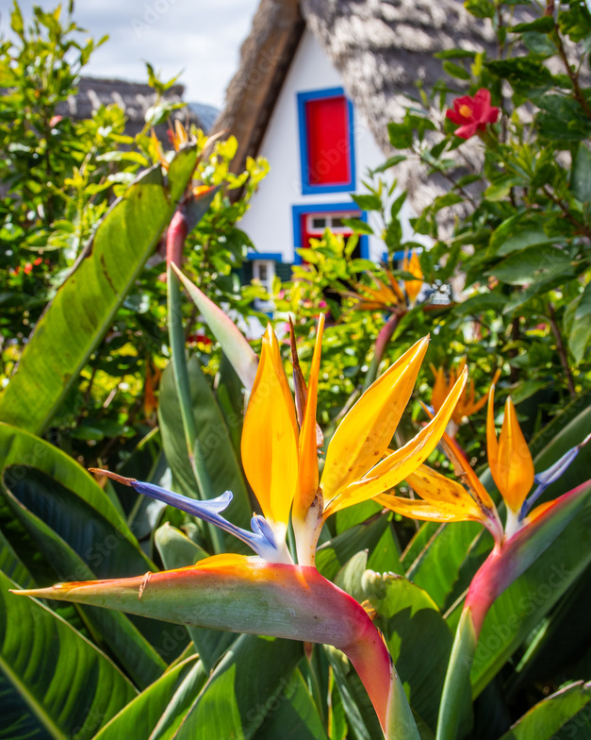
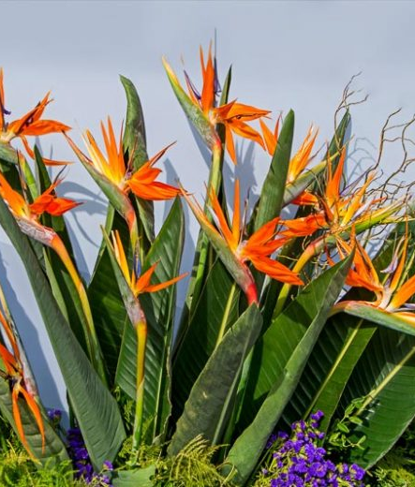
Iconic Plants of Madeira
- Bird of Paradise (Strelitzia): symbol of Madeira

Slide 7
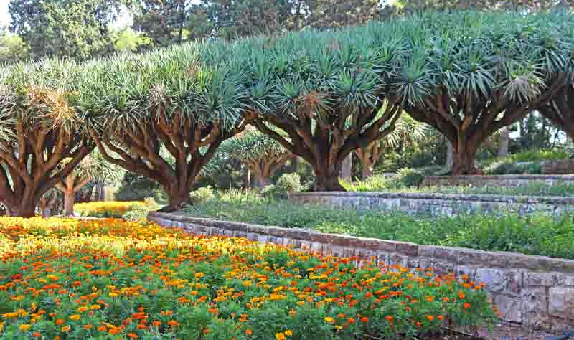
Iconic Plants of Madeira
- Dragon Tree (Dracaena draco): rare and prehistoric

Slide 8
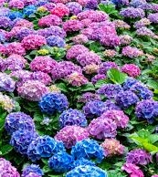
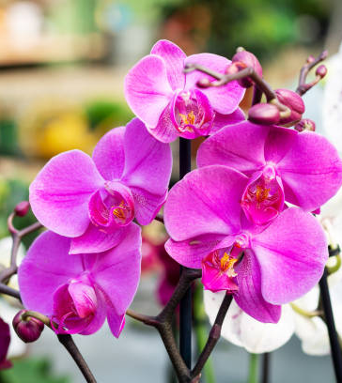
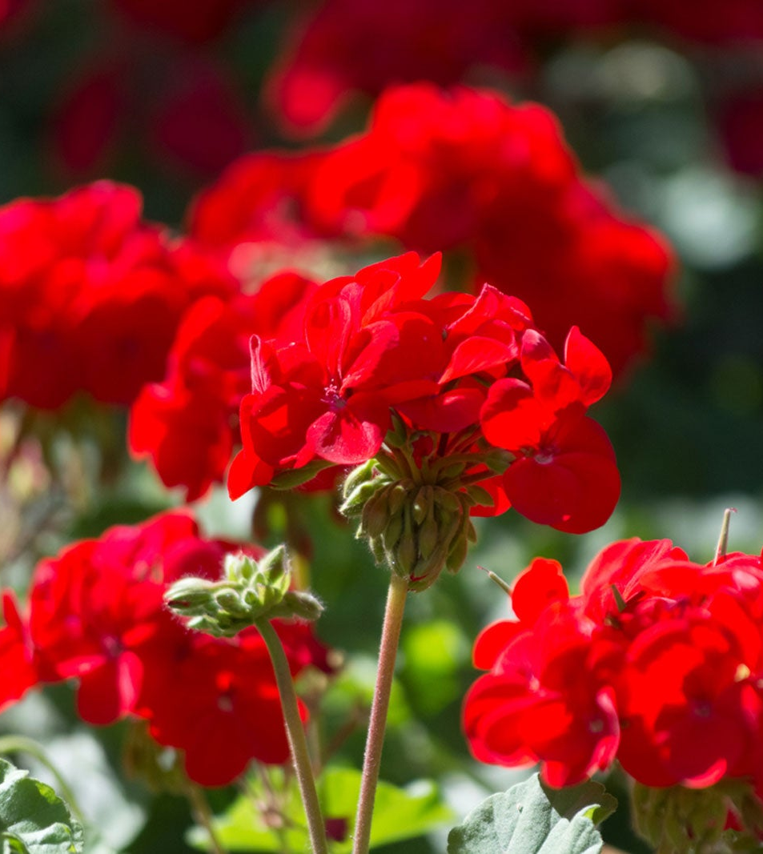
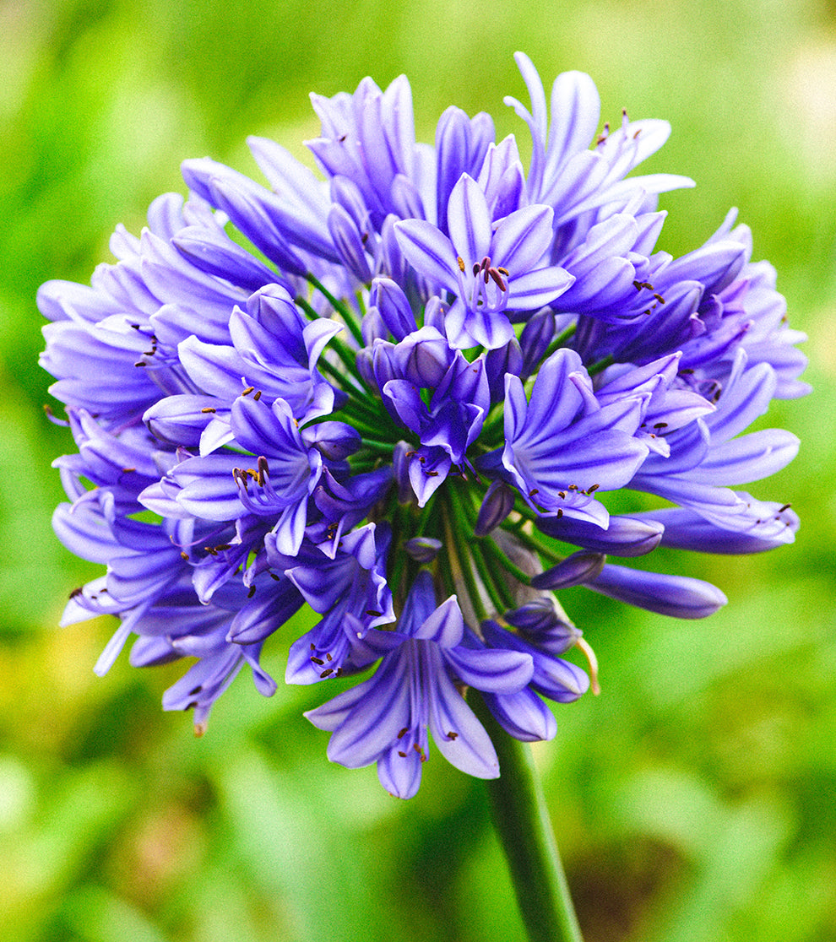
Iconic Plants of Madeira
- Other colorful plants: Hydrangeas, Orchids, Agapanthus, Geraniums

Slide 9
Importance of Madeira’s Flora
- Ecological: Supports unique wildlife and prevents erosion
- Cultural: Deeply tied to local traditions
- Touristic: Attracts visitors for nature walks and 'levadas'

Slide 10
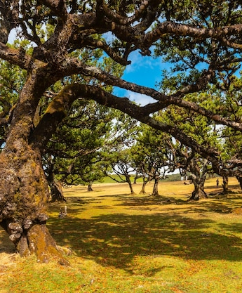
Fun Fact
- Laurissilva Forest covers 20% of Madeira Island
- Some trees are over 800 years old!

Slide 11
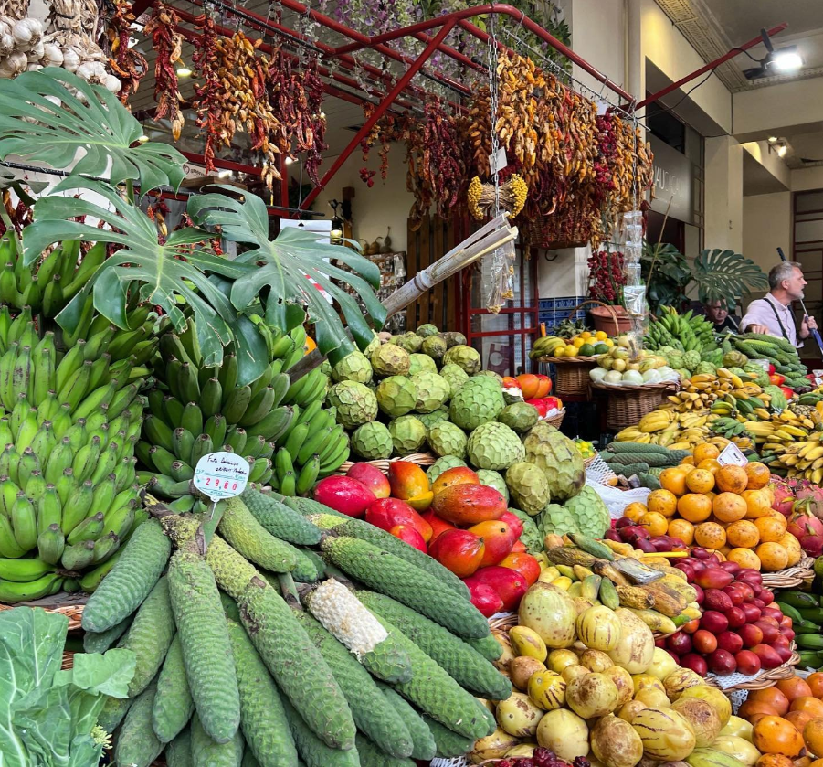
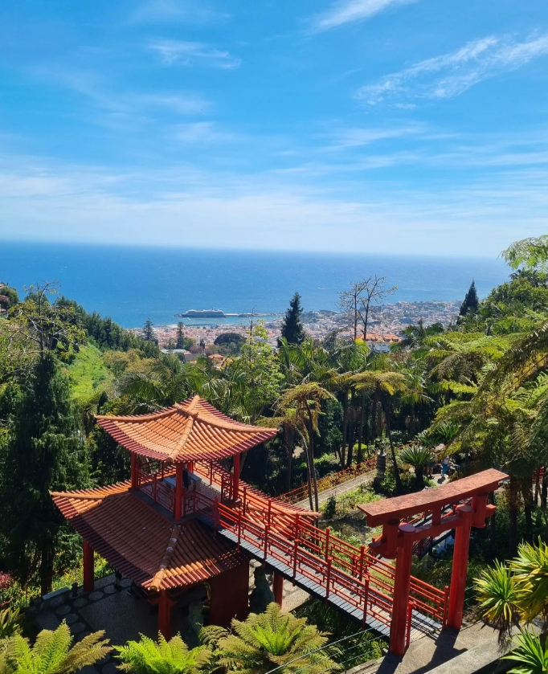
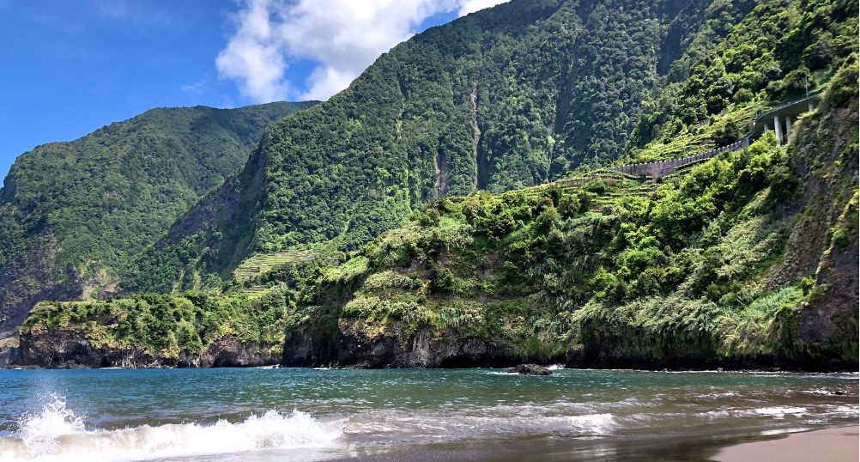
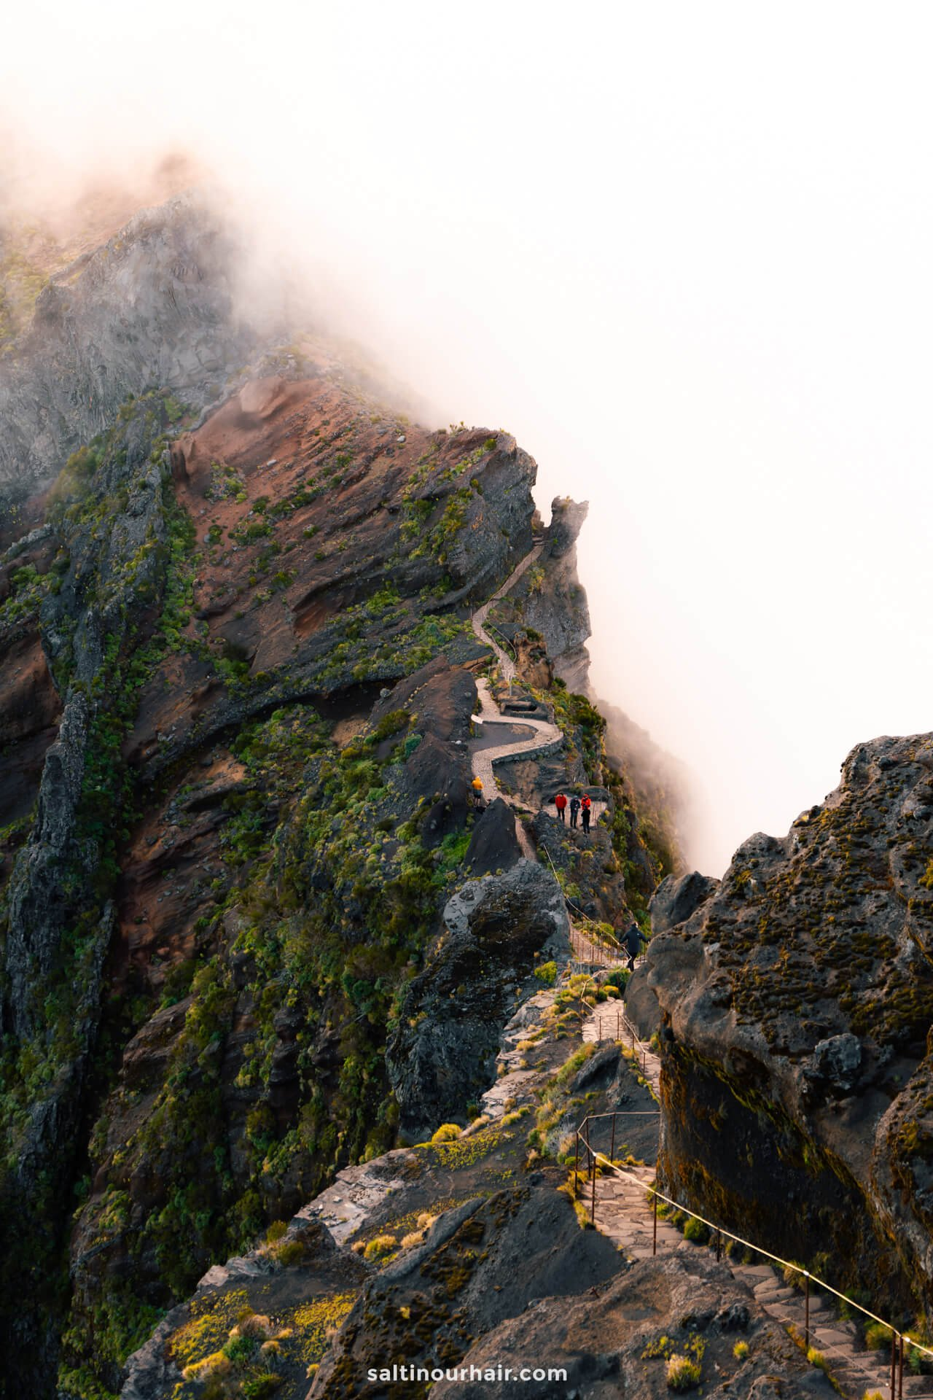
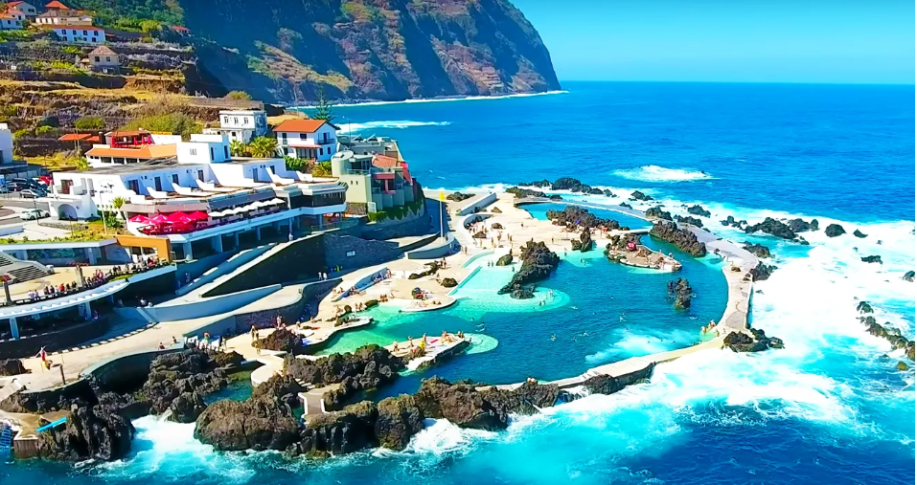
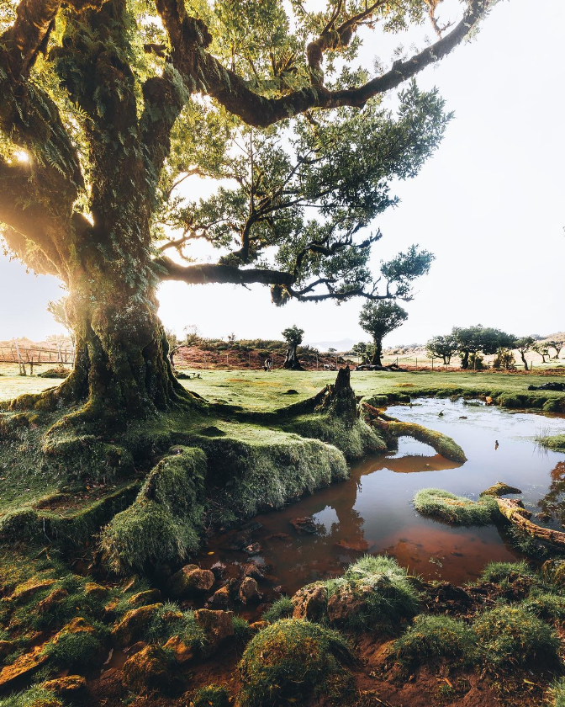
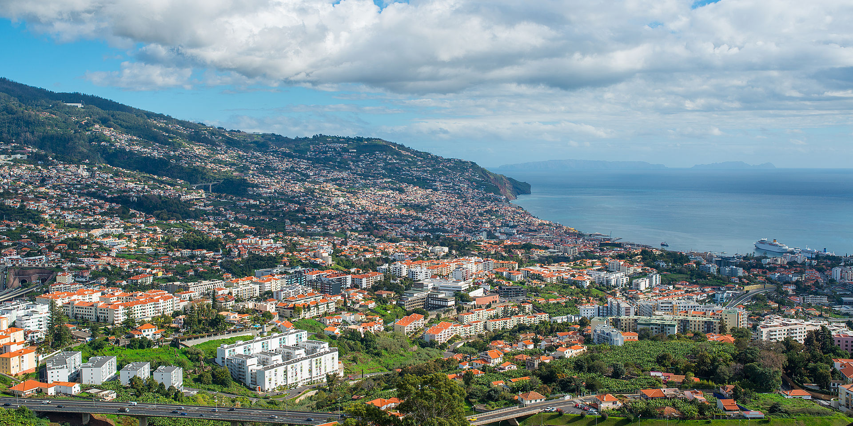
Thank you

