Slide 1
10 PLANTS IN OUR REGION
Kazlų rūdos sav.
Plutiškių gimnazija

Slide 2
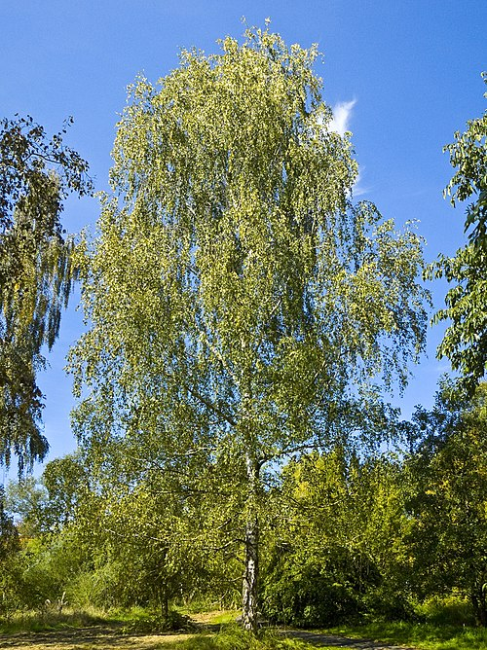
European birch (Karpotasis beržas)
It is a species of deciduous tree in the birch family (Betulaceae), genus (Betula).
A slender tree with striking white bark and delicate, triangular leaves. Very common across Lithuania’s forests and countryside. It’s also a symbol of purity and rebirth in Baltic culture.

Slide 3
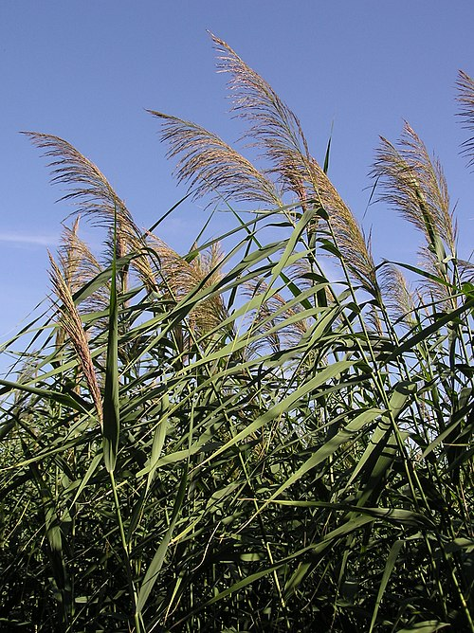
Common reed (Paprastoji nendrė)
A species of plant in the grass family (Poaceae)
Tall, grass-like plant found near lakes and rivers. It forms dense colonies and is vital for wetland ecosystems, providing shelter and stabilizing soil.

Slide 4
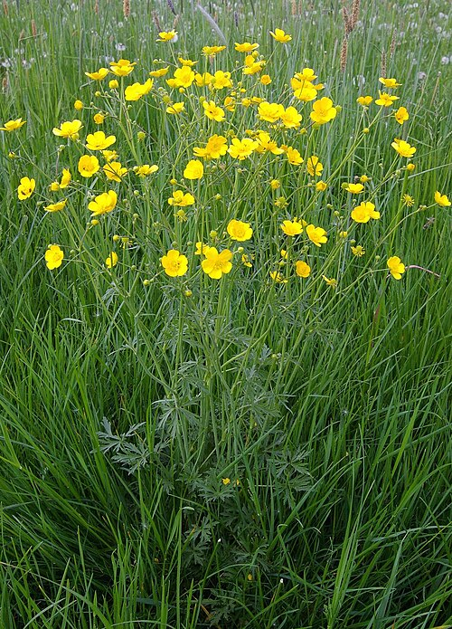
Meadow Buttercup (Vėdrynas)
It is a species of plant in the buttercup family (Ranunculaceae).
A bright yellow wildflower found in meadows and pastures. While beautiful, it’s toxic to livestock when fresh, though drying removes the danger.

Slide 5
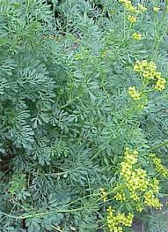
Rue (Rūta)
A genus of herbaceous plants in the family Rutaceae.
A small, bushy herb with blue-green, fern-like leaves and tiny yellow flowers. Known for its strong, bitter scent. Traditionally grown in gardens, it thrives in sunny, dry spots. Rue has deep roots in Lithuanian culture, symbolizing purity and maidenhood, often woven into wreaths for young women in folk traditions.

Slide 6
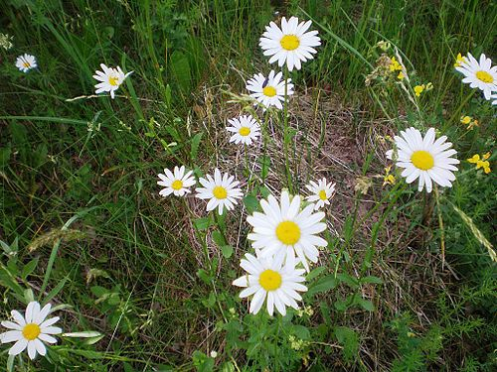
Oxeye Daisy (Paprastoji baltagalvė)
A plant of the Asteraceae family, Leucanthemum genus.
Recognizable by its classic white petals and yellow center. Found in meadows, roadsides, and even gardens, it symbolizes innocence and is common across Lithuania.

Slide 7
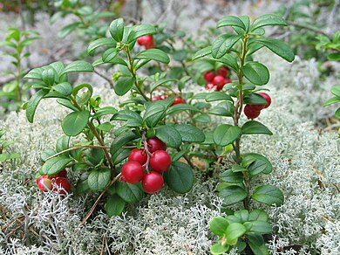
Lingonberry (Bruknė)
A plant of the heather family (Ericaceae).
A small evergreen shrub producing bright red berries. Found in forests and heathlands. The berries are tart and used in traditional Lithuanian jams and dishes.

Slide 8
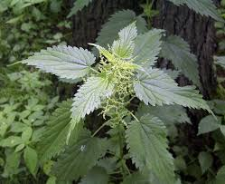
Stinging Nettle (Dilgėlė)
A species of plant in the genus Urtica of the nettle family (Urticaceae).
A prickly plant known for its irritating sting. Despite that, it's a valuable herb in traditional Lithuanian medicine and cuisine, especially in spring soups.

Slide 9
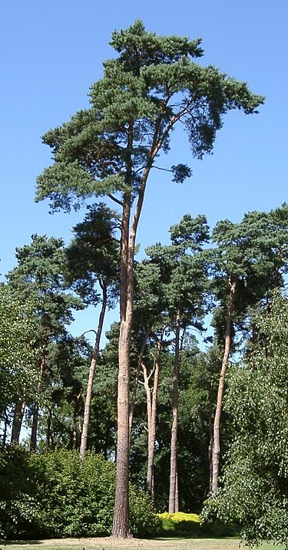
Scots Pine (Paprastoji pušis)
A coniferous evergreen tree of the pine family (Pinaceae), genus Pinus.
One of the most common coniferous trees in Lithuania. It has reddish bark and long needles. Its forests are home to diverse wildlife and used for timber.

Slide 10
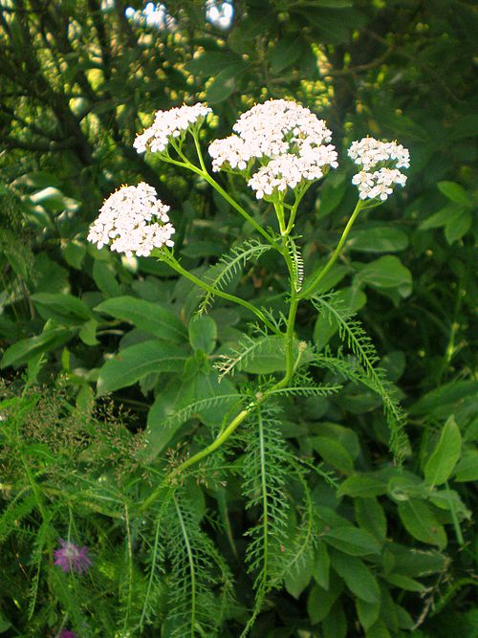
Yarrow (Kraujažolė)
A plant of the Asteraceae family.
A hardy herb with feathery leaves and flat clusters of white or pink flowers. Known for medicinal uses and often grows in meadows or roadside areas.

Slide 11
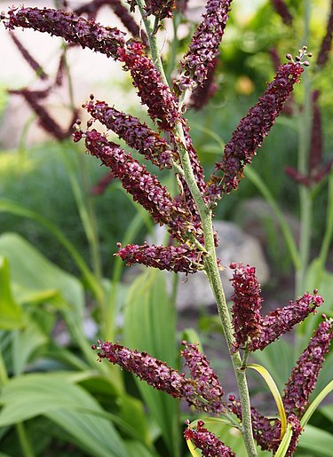
Veratrum (Čemerys)
A genus of plants in the Melanthiaceae family, subclass Liliidae.
A tall, striking plant with broad, pleated green leaves and dense clusters of small, greenish-white flowers. Found in moist meadows, forest edges, and mountain slopes. Despite its beauty, Veratrum is highly toxic — all parts of the plant are poisonous

Slide 12
THANK YOU FOR YOUR ATTENTION

